Slide 1
Chicago Crime Analyzer

Slide 2
Introduction
To analyze the given dataset to derive insights on crimes occurring in Chicago state by observing key patterns and present it in the visualized form

Slide 3
Tools Used
Raw data from excel
Python for Data cleaning, Preprocessing and EDA
Tableau for Data visualization

Slide 4
Dataset Overview
The dataset contains 54999 rows of data.
The various columns includes ID, Case Number, Primary type, arrest made,
Domestic or Non domestic, Latitude Longitude etc..
Rows such as Location Description , Ward, Community Area, X Coordinate ,Y Coordinate, Latitude ,Longitude ,Location contains Null values which needs to be handled
Total 6912 columns does not have 'Latitude', 'Longitude','Location', 'X Coordinate', 'Y Coordinate'values. Making these values as -1 and location to unknown since they represent less than 2% of data
Dropping Ward column since it has too many null values and it is not an essential column for visualization

Slide 5
Key points implemented
Extracted raw data from excel
Done data cleaning, data preprocessing and EDA techniques
Checked for Null values, duplicated values and outliers
Presented the interpretations in visualized form using tableau

Slide 6
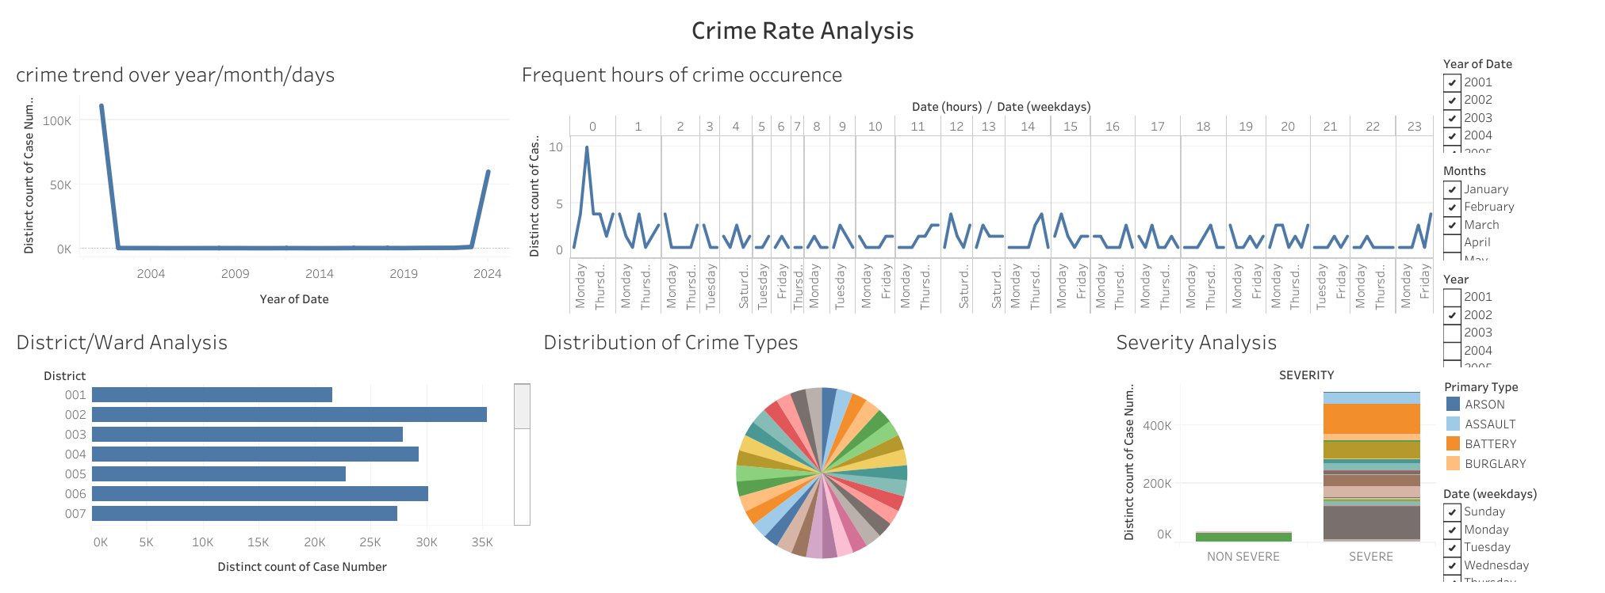
Data Visualiztion using Tableau

Slide 7
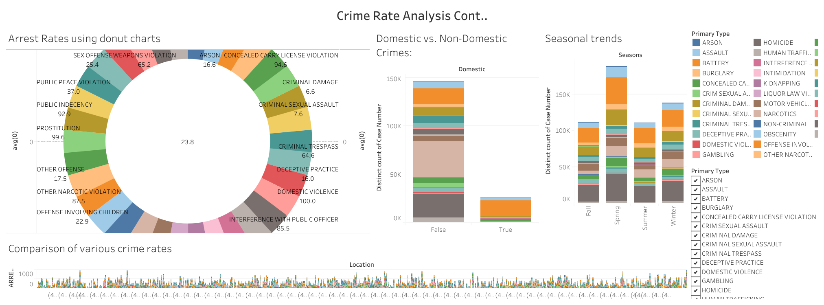
Data Visualiztion using Tableau

Slide 8
THANK YOU

